Slide 1
Week 3
BUS 696: Machine Learning for Managers
Prof. Jonathan Hersh

Slide 2
BUS 696: Week 3 Outline
AI/ML in the News
Bias Variance Tradeoff
Testing/Training split of Data
Creating testing/training splits in R
Simple Linear Regression
Simple Linear Regression in R

Slide 3
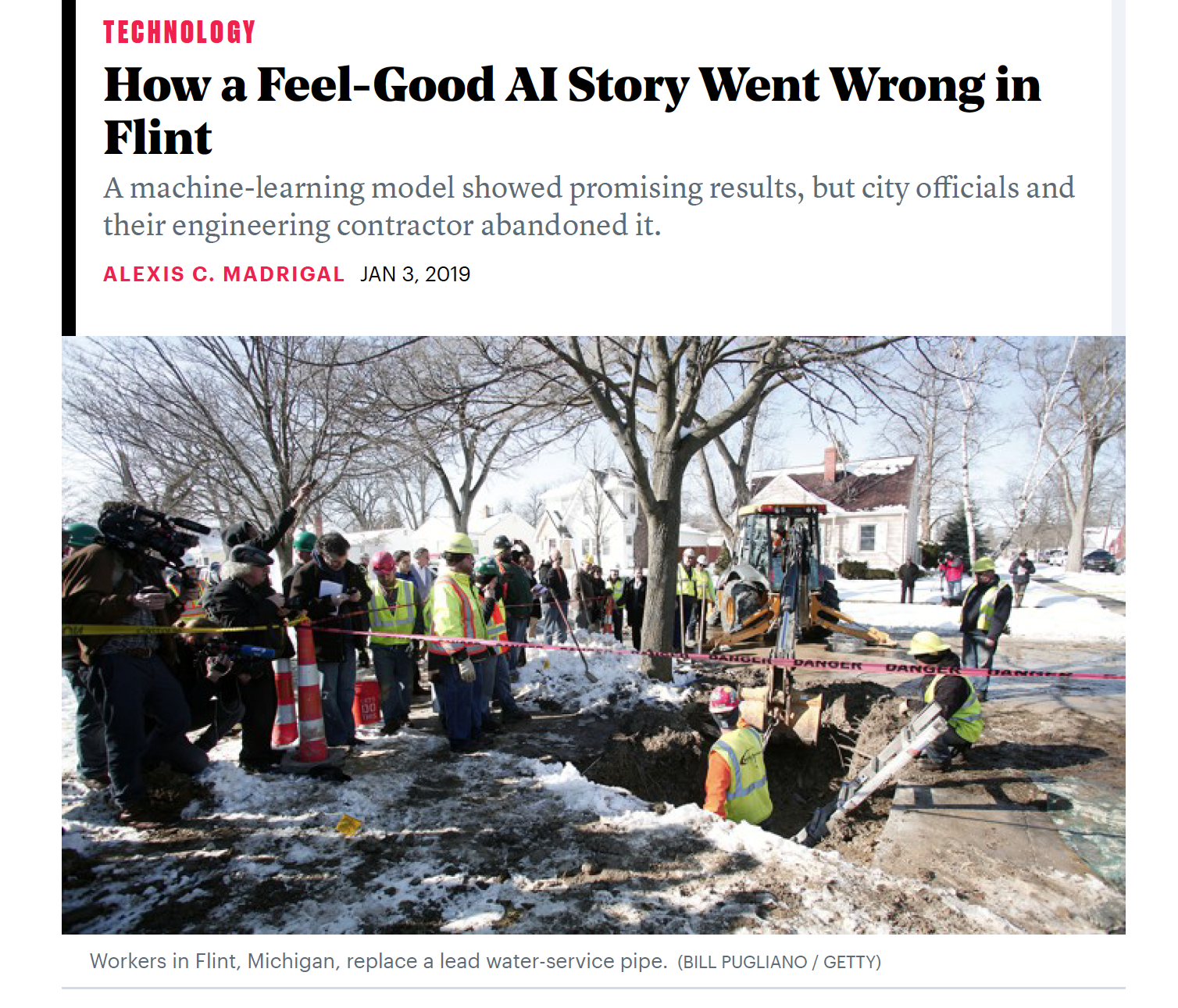

Slide 4
BUS 696: Week 3 Outline
AI/ML in the News
Bias Variance Tradeoff
Testing/Training split of Data
Creating testing/training splits in R
Simple Linear Regression
Simple Linear Regression in R

Slide 5
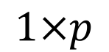
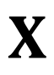
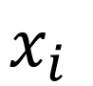
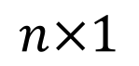

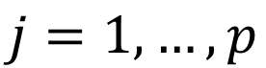
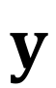
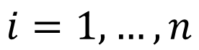
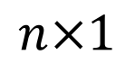
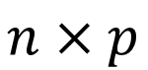
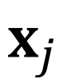
Recall: $X$, $x_{i}$, $x_{j}$ and $y$ for Data
Admit | GRE | GPA
0 | 380 | 3.61
1 | 660 | 3.67
1 | 800 | 4.00
0 | 520 | 2.93
1 | 760 | 3.00
$$X$$
$$x_{i}$$
$$x_{j}$$
$$y$$
$$n×p$$
$$1×p$$
$$n×1$$
$$n×1$$
$$i=1,…,n$$
$$j=1,…,p$$

Slide 6
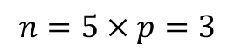

Notation and Matrix Algebra: data matrix $X$
Admit | GRE | GPA
0 | 380 | 3.61
1 | 660 | 3.67
1 | 800 | 4.00
0 | 520 | 2.93
1 | 760 | 3.00
$$X$$
$$n×p$$
$$i=1,…,n$$
$$n=5×p=3$$
$$j=1,…,p$$

Slide 7
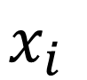

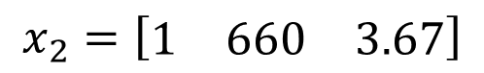
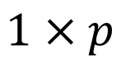
$i_{th}$ Row of $X$
Admit | GRE | GPA
0 | 380 | 3.61
1 | 660 | 3.67
1 | 800 | 4.00
0 | 520 | 2.93
1 | 760 | 3.00
$$x_{i}$$
$$x_{2}=\left[\begin{matrix}1 & 660 & 3.67\end{matrix}\right]$$
$$1×p$$

Slide 8
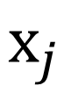

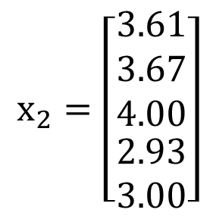
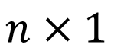
$j_{th}$ column of $X$
Admit | GRE | GPA
0 | 380 | 3.61
1 | 660 | 3.67
1 | 800 | 4.00
0 | 520 | 2.93
1 | 760 | 3.00
$$x_{j}$$
$$x_{2}=\left[\begin{aligned}\begin{matrix}3.61 \\ 3.67 \\ 4.00\end{matrix} \\ 2.93 \\ 3.00\end{aligned}\right]$$
$$n×1$$

Slide 9
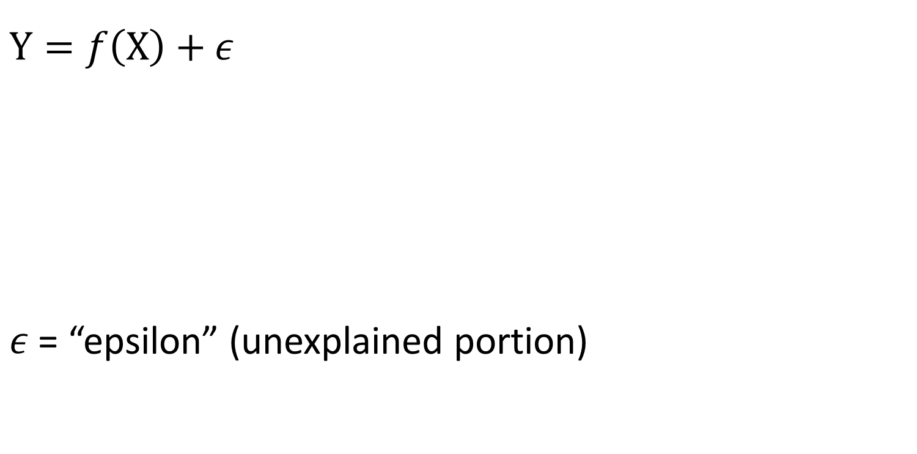
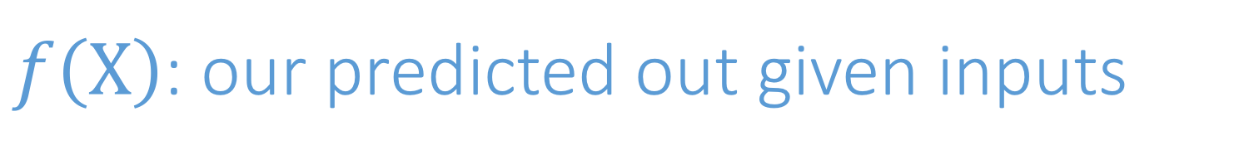
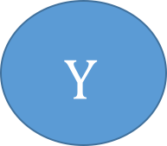


$f\left(X\right)$: our predicted out given inputs
$$Y=f\left(X\right)+ε$$
$ε$ = “epsilon” (unexplained portion)
$$X$$
$$f\left(X\right)$$
$$Y$$

Slide 10
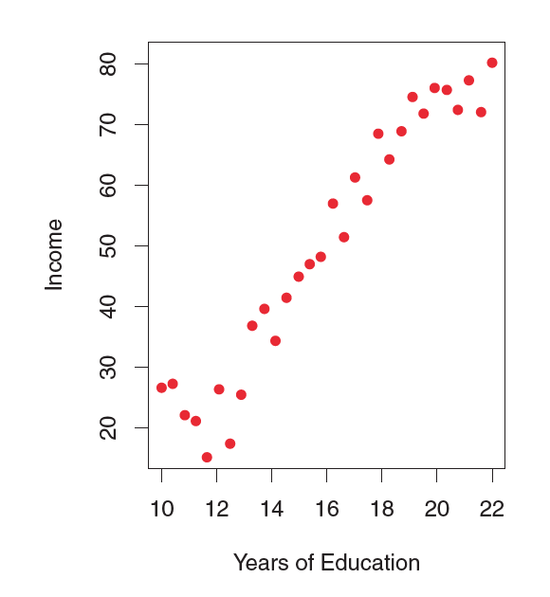
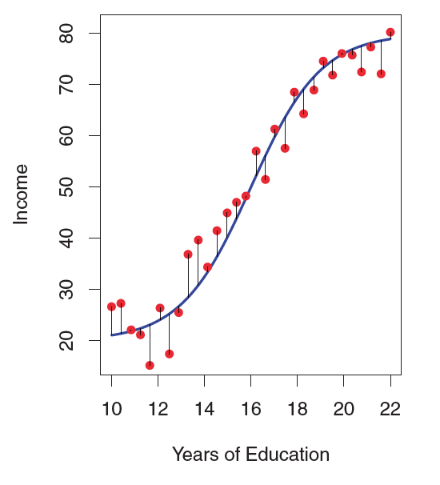
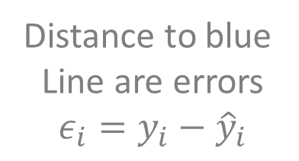
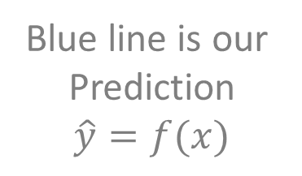
Example: education and income
Blue line is our
Prediction
$$\hat{y}=f(x)$$
Distance to blue
Line are errors
$$ε_{i}=y_{i}−{\hat{y}}_{i}$$

Slide 11
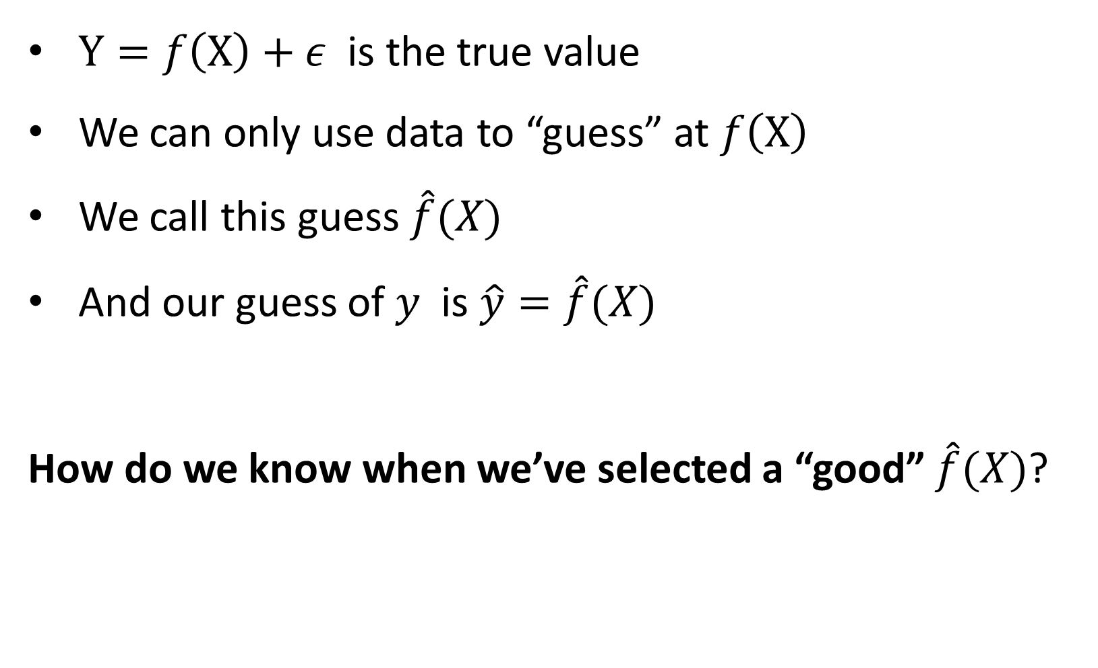
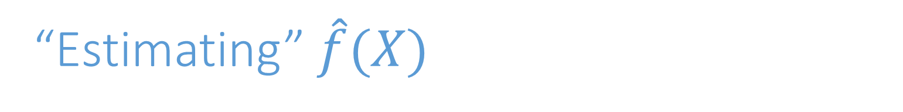
“Estimating” $\hat{f}(X)$
$Y=f\left(X\right)+ε$ is the true value
We can only use data to “guess” at $f\left(X\right)$
We call this guess $\hat{f}(X)$
And our guess of $y$ is $\hat{y}=\hat{f}(X)$
How do we know when we’ve selected a “good” $\hat{f}(X)$?

Slide 12
Bias-Variance Tradeoff

Slide 13
Bias and Variance (conceptually)
Bias: Tendency of an in-sample statistic to over or under estimate the statistic in the population
Variance: Tendency to noisily estimate a statistic. E.g., sensitivity to small fluctuations in the training dataset.

Slide 14
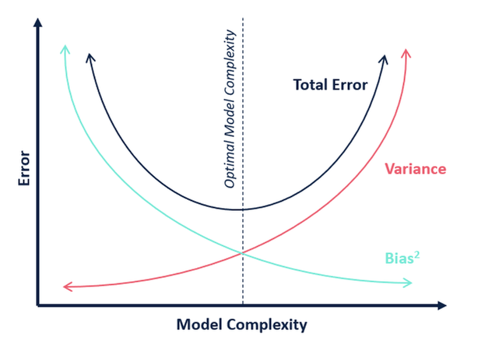
Bias-Variance Tradeoff

Slide 15
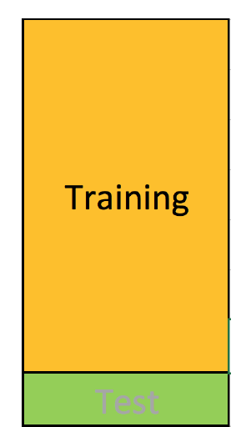
How to Estimate Bias and Variance? Testing/Training Split
Training set: (observation-wise) subset of data used to develop models

Slide 16
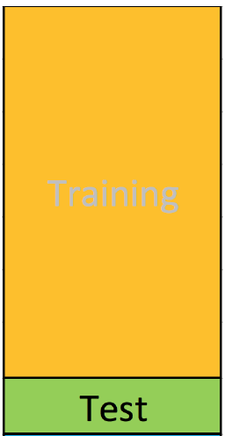
Testing/Training Split
Training set: (observation-wise) subset of data used to develop models
Test set: subset of data used during intermediate stages to “tune” model parameters
Rule of thumb 75% training 25% test -ish

Slide 17
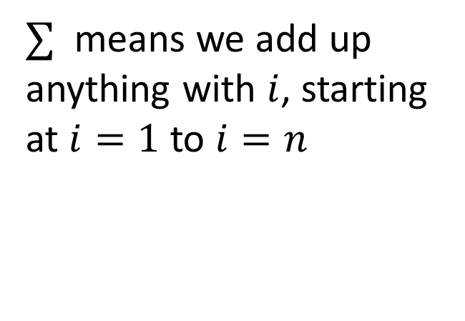
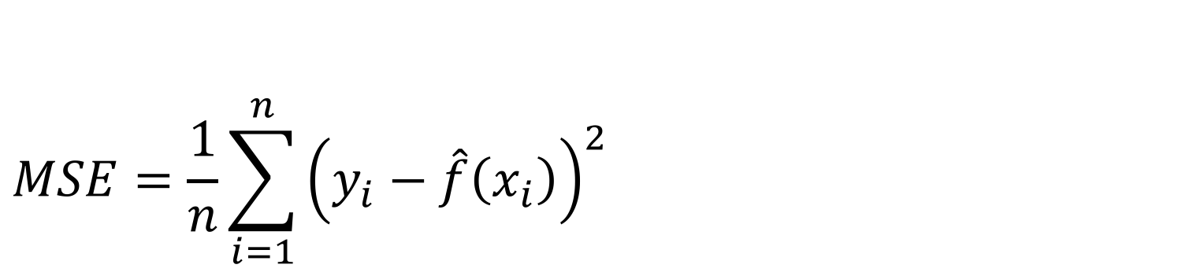
Assessing Model Accuracy: Mean Squared Error
$$MSE=\frac{1}{n}\sum_{i=1}^{n}{{\left(y_{i}−\hat{f}\left(x_{i}\right)\right)}^{2} }$$
$∑$ means we add up anything with $i$, starting at $i=1$ to $i=n$

Slide 18
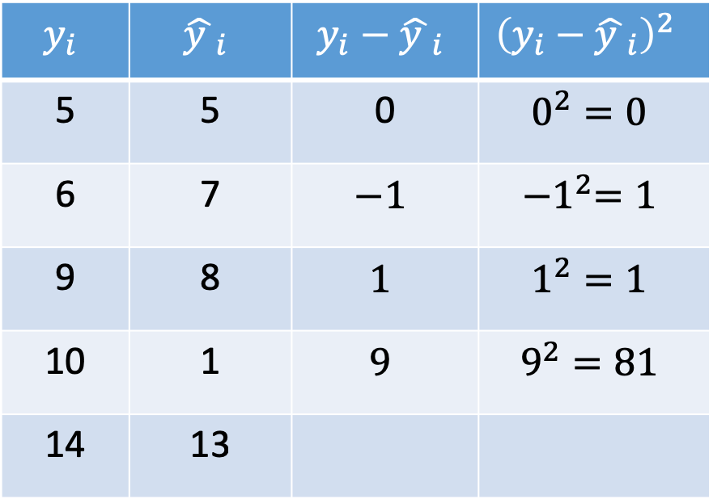
Mean Squared Error in Practice
$$MSE=\frac{1}{n}\sum_{i=1}^{n}{{\left(y_{i}−\hat{f}\left(x_{i}\right)\right)}^{2} }$$
$$y_{i}$$ | $${\hat{y }}_{i}$$ | $$y_{i}−{\hat{y }}_{i}$$ | $${\left(y_{i}−{\hat{y }}_{i}\right)}^{2}$$
5 | 5 | 0 | $$0^{2}=0$$
6 | 7 | $$−1$$ | $${−1}^{2}=1$$
9 | 8 | $$1$$ | $$1^{2}=1$$
10 | 1 | $$9$$ | $$9^{2}=81$$
14 | 13

Slide 19
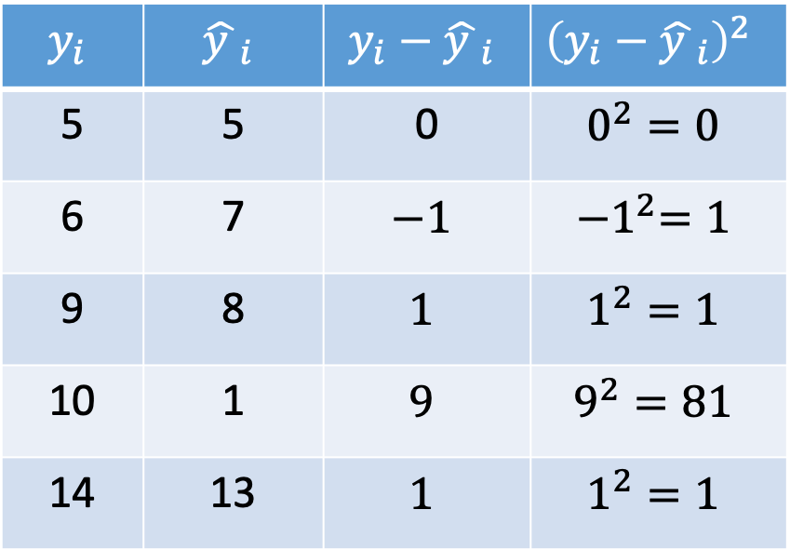
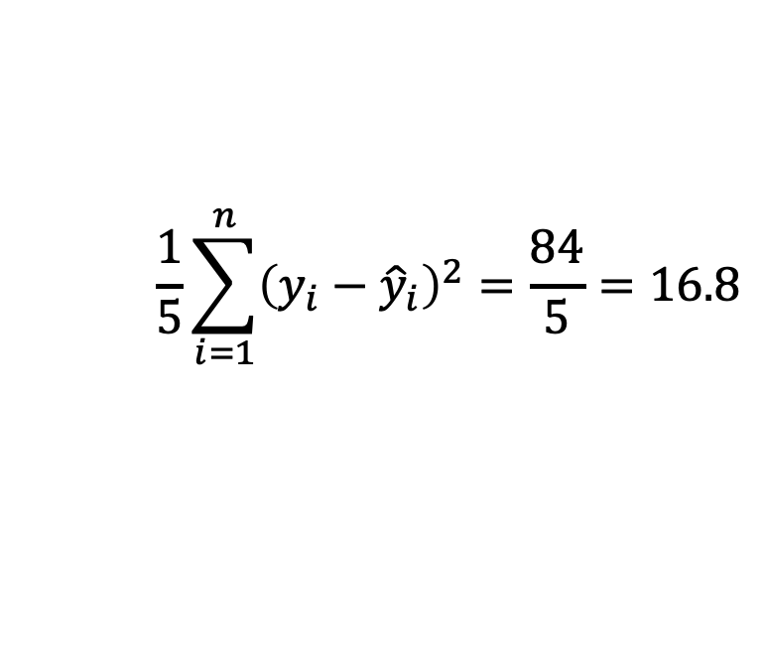
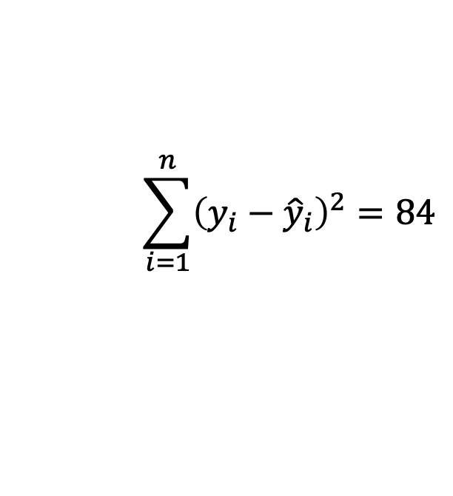
Mean Squared Error in Practice
$$MSE=\frac{1}{n}\sum_{i=1}^{n}{{\left(y_{i}−\hat{f}\left(x_{i}\right)\right)}^{2} }$$
$$y_{i}$$ | $${\hat{y }}_{i}$$ | $$y_{i}−{\hat{y }}_{i}$$ | $${\left(y_{i}−{\hat{y }}_{i}\right)}^{2}$$
5 | 5 | 0 | $$0^{2}=0$$
6 | 7 | $$−1$$ | $${−1}^{2}=1$$
9 | 8 | $$1$$ | $$1^{2}=1$$
10 | 1 | $$9$$ | $$9^{2}=81$$
14 | 13 | $$1$$ | $$1^{2}=1$$
$$\sum_{i=1}^{n}{{\left(y_{i}−{\hat{y}}_{i}\right)}^{2}=84}$$
$$\frac{1}{5}\sum_{i=1}^{n}{{\left(y_{i}−{\hat{y}}_{i}\right)}^{2}=\frac{84}{5}=16.8}$$

Slide 20
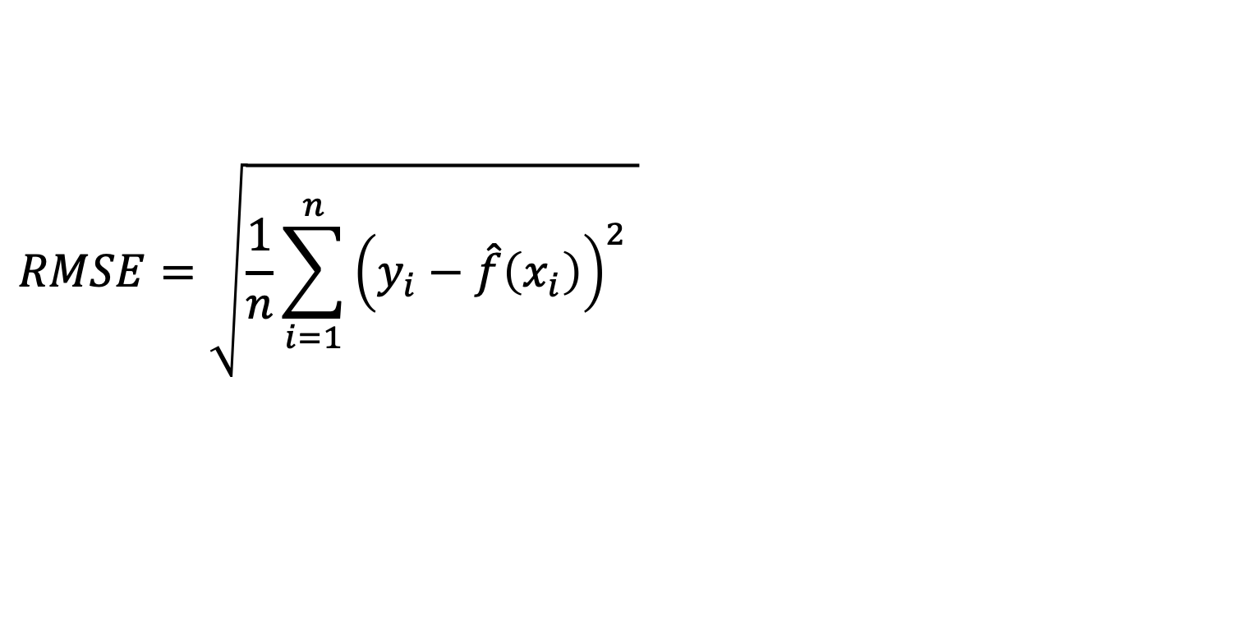
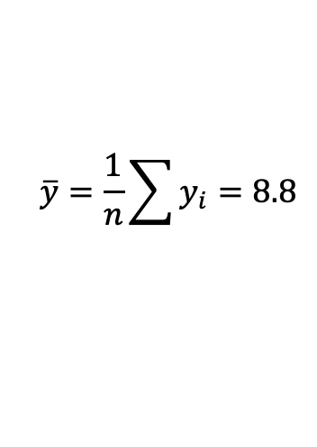
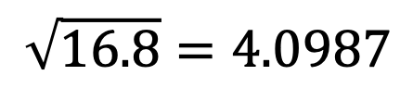
Root Mean Squared Error
$$RMSE=\sqrt{\frac{1}{n}\sum_{i=1}^{n}{{\left(y_{i}−\hat{f}\left(x_{i}\right)\right)}^{2} }}$$
$$y_{i}$$ | $${\hat{y }}_{i}$$ | $$y_{i}−{\hat{y }}_{i}$$ | $${\left(y_{i}−{\hat{y }}_{i}\right)}^{2}$$
5 | 5 | 0 | $$0^{2}=0$$
6 | 7 | $$−1$$ | $${−1}^{2}=1$$
9 | 8 | $$1$$ | $$1^{2}=1$$
10 | 1 | $$9$$ | $$9^{2}=81$$
14 | 13 | $$1$$ | $$1^{2}=1$$
$$\sqrt{16.8}=4.0987$$
Why is this useful?
Transformed
Back to units of original y_i
$$\overline{y}=\frac{1}{n}\sum{y_{i}}=8.8$$

Slide 21
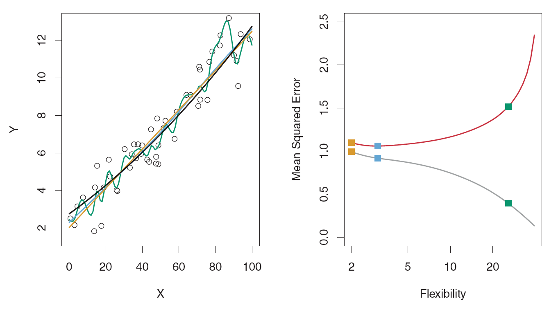
Example: Overfitting (True Relationship Linear)
Training Data
Results on Test Data
3 Models
Simple (linear): gold line
Moderate complexity
(linear): blue line
Very complicated:
green line
Black line: true relationship
Data points (true relationship observed with noise)

Slide 22
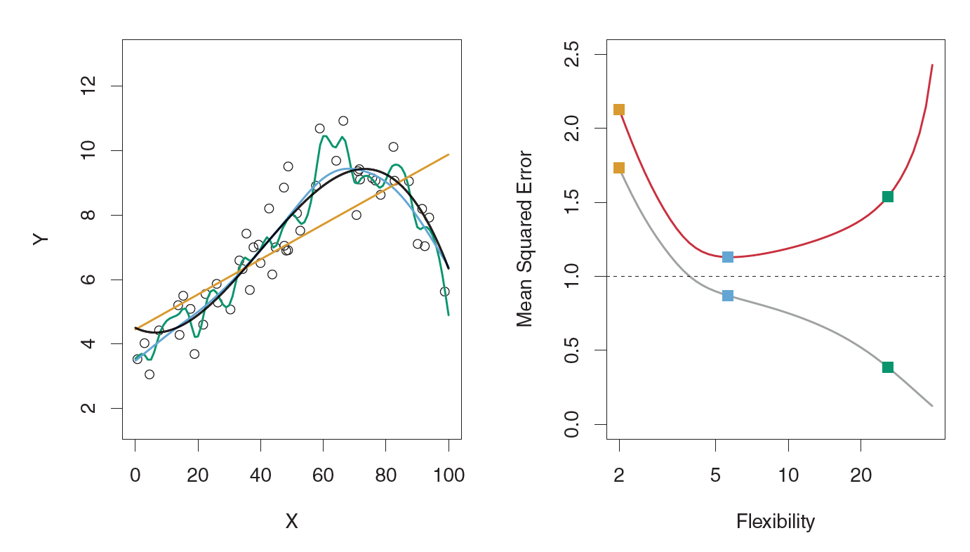
Example: Overfitting (True Relationship Slightly Complicated)
Training Data
Results on Test Data
Simple (linear): gold line
Moderate complexity
(linear): blue line
Very complicated:
green line

Slide 23
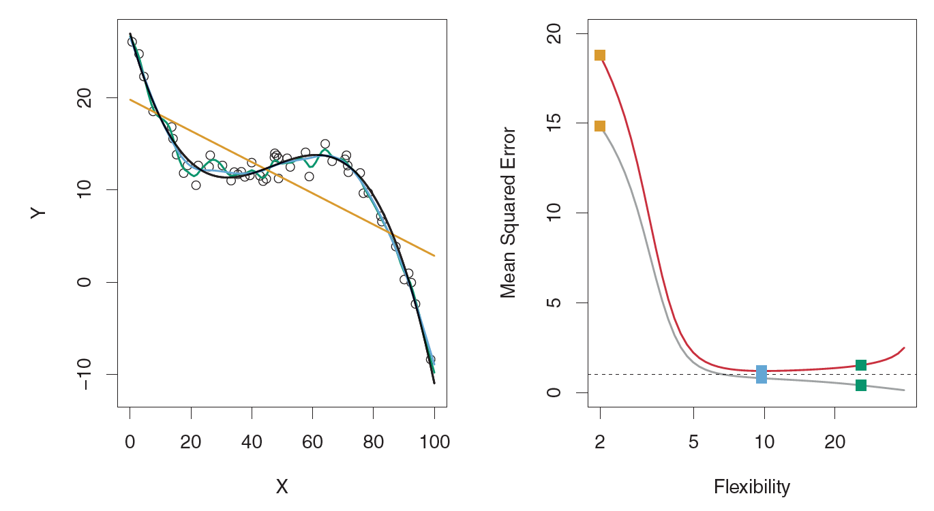
Example: Overfitting (True Relationship Very Complicated)
Training Data
Results on Test Data
Simple (linear): gold line
Moderate complexity
(linear): blue line
Very complicated:
green line

Slide 24
Linear Regression
Training set: (observation-wise) subset of data used to develop models
Test set: subset of data used during intermediate stages to “tune” model parameters
Rule of thumb 75% training 25% test -ish

Slide 25
BUS 696: Week 3 Outline
AI/ML in the News
Bias Variance Tradeoff
Testing/Training split of Data
Creating testing/training splits in R
Simple Linear Regression
Simple Linear Regression in R

Slide 26
BUS 696: Week 3 Outline
AI/ML in the News
Bias Variance Tradeoff
Testing/Training split of Data
Creating testing/training splits in R
Simple Linear Regression
Simple Linear Regression in R

Slide 27
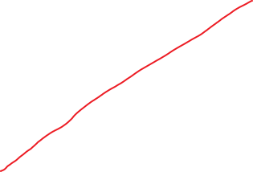


What is Linear Regression?
Regression: statistical process of estimating relationship between an outcome and and one or more predictors or independent variables
Sales
(dependent or outcome variable)
Linear Regression: restricting relationship between predictors and outcome to be linear
Advertising
(independent variable)

Slide 28

Linear Regression Equation
$$y_{i}=β_{0}+β_{1}x_{Advertising}+ε_{i}$$
Red line chosen in a special way…we’ll get to that
For now, it “explains” the data the best
Sales
(dependent or outcome variable)
Advertising
(independent variable)
100m

Slide 29

Linear Regression as Prediction
$$y_{i}=β_{0}+β_{1}x_{Advertising}+ε_{i}$$
Suppose we spend 100m on advertising?
What’s our expected sales?
Sales
(dependent or outcome variable)
$$?={\hat{β}}_{0} +\hat{β_{1}}100m$$
Advertising
(independent variable)
100m

Slide 30

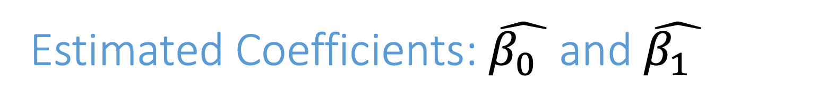
Estimated Coefficients: $\hat{β_{0} }$and $\hat{β_{1} }$
$$y_{i}=β_{0}+β_{1}x_{Advertising}+ε_{i}$$
Suppose we spend 100m on advertising?
What’s our expected sales?
Sales
(dependent or outcome variable)
$$?=\hat{β_{0} } +\hat{β_{1}}100m$$
Advertising
(independent variable)
100m
“Hat”, e.g. $\hat{β_{0} }$, means we’ve estimated this relationship from data.

Slide 31

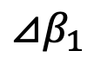
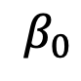
Estimated Coefficients: $\hat{β_{0} }$and $\hat{β_{1} }$
$$y_{i}=β_{0}+β_{1}x_{Advertising}+ε_{i}$$
$$⊿β_{1}$$
Suppose we spend 100m on advertising?
What’s our expected sales?
Sales
(dependent or outcome variable)
$$β_{0}$$
$$?=\hat{β_{0} } +\hat{β_{1}}100m$$
Advertising
(independent variable)
100m
$$?=10 +1∗100$$
$$110=10 +1∗100$$
“Hat”, e.g. $\hat{β_{0} }$, means we’ve estimated this relationship from data.

Slide 32
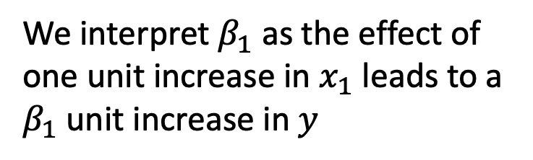
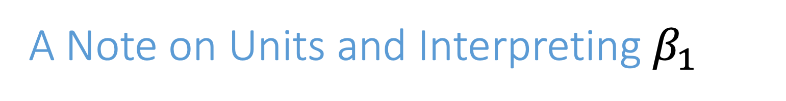

A Note on Units and Interpreting $β_{1}$
We interpret $β_{1}$ as the effect of one unit increase in $x_{1}$ leads to a $β_{1}$ unit increase in $y$
$$⊿β_{1}$$
Sales
(dependent or outcome variable)
$$?=10 +1∗100$$
$$110=10 +1∗100$$
$$β_{0}$$
A one unit change in advertising (millions) leads to a 1 (units of y) increase in sales
Advertising
(independent variable)
$$y_{i}=β_{0}+β_{1}x_{Advertising}+ε_{i}$$

Slide 33
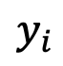
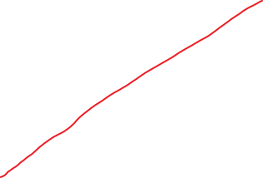




Measuring Errors
$$y_{i}=β_{0}+β_{1}x_{Advertising}+ε_{i}$$
$${\hat{y}}_{i}$$
Errors:
$$ε_{i}=y_{i}−{\hat{y}}_{i}$$
Sales
(dependent or outcome variable)
50
Error:
$${\hat{ε}}_{i}=10−50=−40$$
10
$$y_{i}$$
Advertising
(independent variable)
Errors are the difference between what we predict (${\hat{y}}_{i}$) and the actual values ($y_{i}$).

Slide 34
BUS 696: Week 3 Outline
AI/ML in the News
Bias Variance Tradeoff
Testing/Training split of Data
Creating testing/training splits in R
Simple Linear Regression
Simple Linear Regression in R

Slide 35

Interpreting Regression Output
Residual stats
Coefficient Magnitude
Std. Error
T-stat (t-value)
P-Value
R-squared
F-Stat

Slide 36

Hypothesis Testing Coefficients
$H_{0}$: There is no linear relationship between $X$ and $Y$
Null hypothesis: $β=0$
$H_{1}$: There is some linear relationship between $X$ and $Y$
P-value tells us the likelihood that, if the null hypothesis were true, we would receive a result as extreme as the one seen

Slide 37
What do p-values measure?
P-value does not measure
P-value tells us the likelihood that, if the null hypothesis were true, we would receive a result as extreme as the one seen
Small p-values: unlikely that we would receive a result as extreme if the null is true
Size of effect
Importance of a result
Probability the alternative hypothesis is true
It just tells us how likely we would see the coefficient we see if beta is really equal to zero

Slide 38


T-Stat and F-Statistic
$$t=\frac{{\hat{β}}_{1}−0}{SE\left({\hat{β}}_{1}\right)}$$
Large t-stat in abs value -> big effect size
$$F=\frac{\left(TSS−RSS\right)/p}{RSS/(n−p−1)}$$
F –stat tells us joint significance of model

Slide 39





Total Sum of Squares, Residual Sum of Squares and R-Squared
$$F=\frac{\left(TSS−RSS\right)/p}{RSS/(n−p−1)}$$
$$TSS=\sum_{i=1}^{n}{{\left(y_{i}−\overline{y}\right)}^{2} }$$
TSS: Total Sum of Squares
$$RSS=\sum_{i=1}^{n}{{\left(y_{i}−\hat{y_{i}}\right)}^{2} }$$
RSS: Residual Sum of Squares
$$R^{2}=\frac{TSS−RSS}{TSS}=\frac{TSS}{TSS}−\frac{RSS}{TSS}=1−\frac{RSS}{TSS}$$
$${⇒R}^{2}∈[0,1]$$

Slide 40


R^2: Measuring goodness of fit

Slide 41

Adding More Variables
$$gross_{i}=β_{0}+β_{1}x_{budget}+β_{2}⋅x_{imdb_score}+ε_{i}$$
$$\hat{gross_{i}}=−54.5+0.0273⋅x_{budget}+17.29⋅x_{imdb_score}+ε_{i}$$

Slide 42


Including Qualitative Predictors (Dummy Variables)
Every qualitative predictor (factor) has been transformed into a column of binary information corresponding to that factor level

Slide 43

Factor: Switches, Continuous: Sliders
$$gross_{i}=β_{0}+β_{1}x_{budget}+β_{2}⋅x_{imdb_score}+ε_{i}$$
$$gross_{i}=β_{0}+β_{1}x_{StevenSpielberg}+β_{2}⋅x_{MichaelBay}+ε_{i}$$
Source: https://twitter.com/andrewheiss/status/1171084259660107777?s=20

Slide 44

Factor: Switches, Continuous: Sliders
$$gross_{i}=β_{0}+β_{1}x_{budget}+β_{2}⋅x_{imdb_score}+ε_{i}$$
$$gross_{i}=β_{0}+β_{1}x_{budget}+β_{2}⋅x_{imdb_{score}}+β_{3}⋅MichaelBay+β_{4}⋅StevenSpielberg+ε_{i}$$
Source: https://twitter.com/andrewheiss/status/1171084259660107777?s=20

Slide 45
“Base” Levels and Interpreting Factors
budget | Director | Director_Michael_Bay | Director_StevenSpielBerg
14M | Werner Herzog | 0 | 0
250M | Michael Bay | 1 | 0
160M | Michael Bay | 1 | 0
17M | Wes Anderson | 0 | 0
100M | David Fincher | 0 | 1
Source: https://twitter.com/andrewheiss/status/1171084259660107777?s=20

Slide 46
Potential Problems with Regressions
Non-linearity between Y and X
Correlation of error terms
Non-constant variance of error term
Outliers
High-leverage points
Collinearity
Correlation vs Causation

Slide 47

Log transformations

Slide 48

Interactions and log transformations in R

Slide 49

Correlation of error terms

Slide 50

Diagnostics: non-constant variance of error

Slide 51


Slide 52

Plot fitted values against residuals

Slide 53
Scale-Location plots (note standardized residuals)

Slide 54

Outliers

Slide 55



Leverage statistic (hat statistic)
$$h_{i}=\frac{1}{n}+\frac{{\left(x_{i}−\overline{x}\right)}^{2}}{\sum_{i^{′}=1}^{n}{{\left(x_{i^{′}}−\overline{x}\right)}^{2}}}$$
$$h_{i}∈\left[\frac{1}{n},1\right]$$
$$Average=(p+1)/n$$

Slide 56


Slide 57

Collinearity

Slide 58

Impact of collinearity

Slide 59



Testing for collinearity: VIF (olsrr package)
$VIF\left({\hat{β}}_{j}\right)=\frac{1}{1−R_{X_{j}|X_{−j} }^{2}}$

Slide 60

Spurious Relationship?
Source: http://www.tylervigen.com/spurious-correlations

Slide 61

Spurious Relationship?
Source: http://www.tylervigen.com/spurious-correlations

